Slide 1
Physical Layer
Chapter 4

Slide 2

Chapter 4
Physical Layer

Slide 3
Outline
Physical Layer Technologies
Overview of RF Wireless Communication
Channel Coding (Error Control Coding)
Modulation
Wireless Channel Effects
Physical Layer Standards

Slide 4
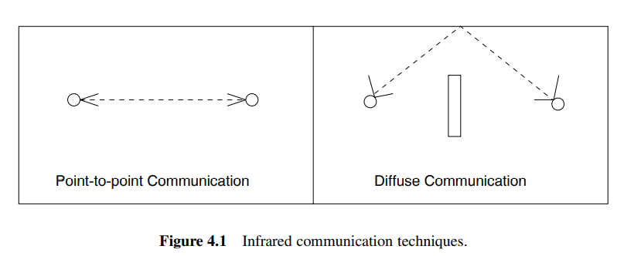
Physical Layer Technologies
In general, wireless links can be formed by RF, optical, acoustic, or magnetic induction techniques.
1. Radio Frequency (RF): The main types of technologies used for RF communication in WSNs can be classified into three as narrow-band, spread-spectrum, and ultra-wide-band (UWB) techniques.
2. Optical Communication: Infrared communication can be performed in two ways as shown in
Figure 4.1, point-to-point communication and
diffuse communication.
3. Acoustic Communication: acoustic links are also
classified as vertical and horizontal.
4. Magnetic Induction Communication.

Slide 5
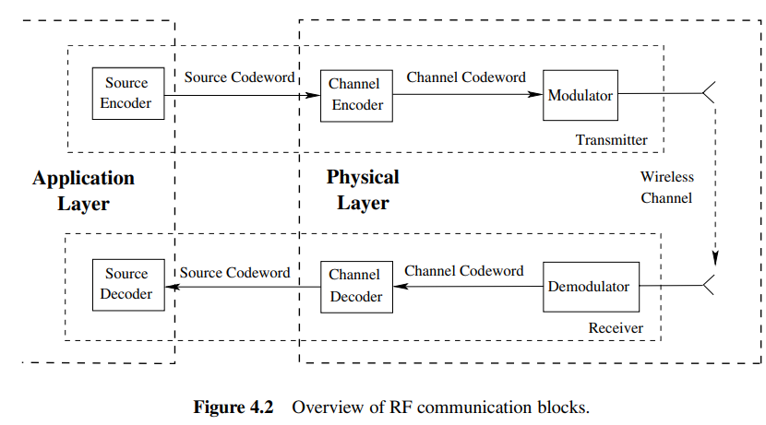
RF Wireless Communication
The following are performed to transmit information between a transmitter and a receiver:
Source coding (data compression):
At the transmitter end, the information source is first encoded with a source encoder
Exploit the information statistics
Represent the source with a fewer
number of bits
→ source codeword
Performed at the application layer

Slide 6
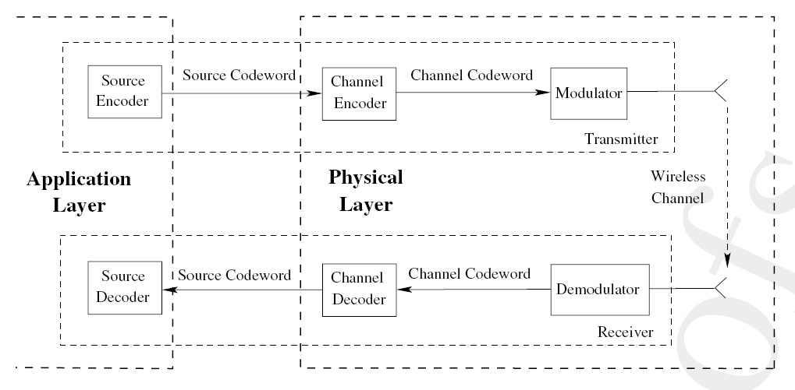
RF Wireless Communication
Channel coding (error control coding):
Source codeword is then encoded by the channel encoder.
→ channel codeword
Goal: address the wireless
channel errors that affect
the transmitted information.

Slide 7
RF Wireless Communication
3. Interleaving and modulation:
The encoded channel codeword is then interleaved to combat the bursty errors
Channel coding and the interleaving mechanism help the receiver either to
Identify bit errors to initiate
retransmission.
Correct a limited number of bits
in case of errors.

Slide 8
RF Wireless Communication
Then, an analog signal (or a set thereof) is modulated by the digital information to create the waveform that will be sent over the channel
Finally, the waveforms are transmitted through the antenna to the receiver

Slide 9
RF Wireless Communication
4. Wireless channel propagation:
The transmitted waveform travels through the channel
Meanwhile, the waveform is attenuated and distorted by several wireless channel effects

Slide 10
Channel coding (error control coding)
Block Codes:
A block code transforms an input message u of k bits into an output message v of n bits, n>k.
The output message v is denoted as the channel codeword. Depending on the complexity of the code, each code is capable of correcting up to t bits in error.
The error detection and error correction capabilities of block codes are determined by the minimum distance of the code.

Slide 11
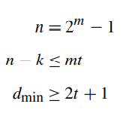
Block Codes
Three main types of block codes are used in WSNs in general:
BCH (Bose, Chaudhuri, and Hocquenghem) Codes:
A BCH code is identified by a tuple (n, k, t ), where n is the block length, k is the information length, and t is the maximum number of errors that can be corrected. The following hold true for any BCH code:

Slide 12
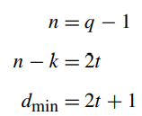
Block Codes
RS (Reed–Solomon) Codes:
While they retain the properties of binary BCH codes, the following hold true for all RS codes:
CRC (Cyclic Redundancy Check) codes:
CRC codes detect whether a packet is received in error or not. However, they cannot correct these errors.

Slide 13
Channel coding (error control coding)
Joint Source–Channel Coding:
In distributed networks, where the information about an event is more important than the individual readings of each sensor, joint source–channel coding results in optimal results.
For the case of Gaussian sensor networks, where the source and noise statistics follow a Gaussian distribution, in addition to outperforming separation techniques, joint source–channel coding also leads to the optimum communication solution

Slide 14
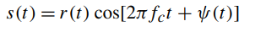
Modulation
The conversion from the bit streams to the waveforms is accomplished by modulation techniques. In a typical modulation scheme, a waveform is a sinusoid of the form:
which has three main components:
Amplitude r(t): The amplitude or envelope of the waveform.
Frequency fc: The center frequency of the waveform.
Phase ψ(t): The phase of the waveform.

Slide 15
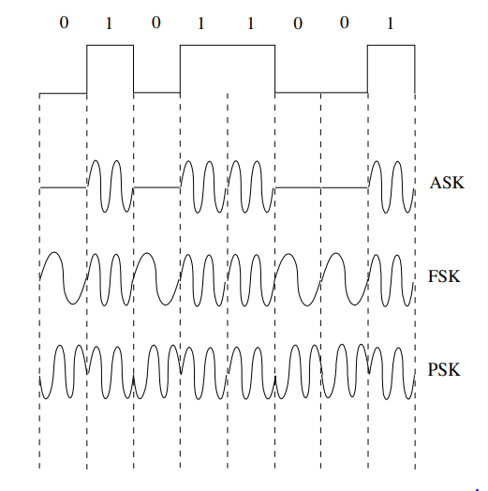
Modulation Schemes
Amplitude shift keying (ASK): the simplest form of ASK is ON–OFF keying (OOK), which transmits a waveform for a digital 1 and keeps silent for the duration of a digital 0.
Frequency shift keying (FSK): the frequency, fc, of the waveform is varied based on the information bit to be transmitted.
Phase shift keying (PSK): PSK is based on modifying the phase of the waveform, ψ (t ), according to the transmitted bits.

Slide 16
Receiver: Demodulation
Receiver tries to match the received waveform with the tx’ed data bit
Necessary: one-to-one mapping between data and waveform
Problems (Wireless Channel Errors)
Carrier synchronization: Frequency can vary between sender and receiver (drift, temperature changes, aging, …)
Bit synchronization: When does symbol representing a certain bit start/end?
Frame synchronization: When does a packet start/end?
Biggest problem: Received signal is not the transmitted signal!

Slide 17
Wireless Channel Effects
The wireless channel distorts signals transmitted from a transceiver. The sources of this distortion can be classified into four main phenomena:
Attenuation: As the signal wave propagates through air, the signal strength is attenuated.
Reflection and refraction: When a signal wave is incident at a boundary between two different types of material, a certain fraction of the wave bounces off the surface, which is called reflection.
Diffraction: A signal wave may also propagate through sharp edges such as the tip of a mountain or a building.
Scattering: when a signal wave is incident at a rough surface, it scatters in different directions.

Slide 18
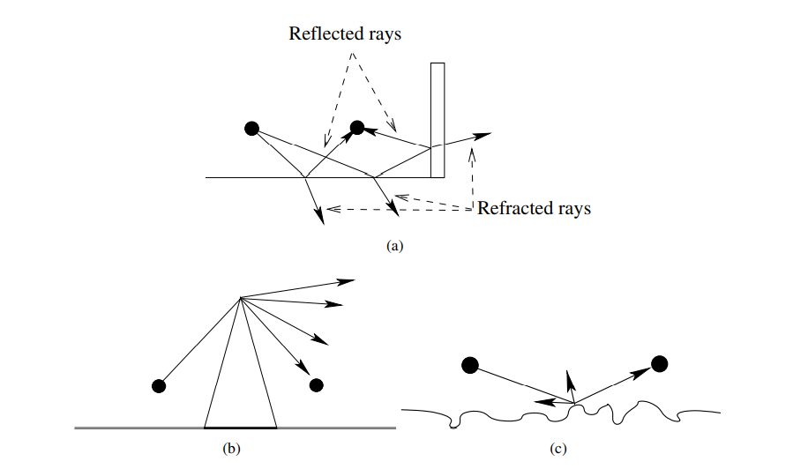
Sources of distortion in wireless communication
Diffraction
Scattering

Slide 19
Attenuation
Attenuation in air results in path loss for the EM waves.
The signal strength decreases as a function of distance. This decrease also defines the transmission range of a node.
If the signal strength decreases below a certain threshold, the receiver cannot correctly detect the EM wave and decode the signal.
This threshold is referred to as the receiver sensitivity.
The distance at which the signal strength drops below the receiver sensitivity can be regarded as the maximum communication distance or the transmission range of a node.

Slide 20
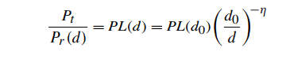
Attenuation
Attenuation is generally modeled based on empirical evaluations, which show that signal strength decreases as a function of the distance, d, between the transmitter and the receiver.
The attenuation of the wireless channel can be generalized by representing the path loss PL(d) as the ratio of the transmitted power, Pt , and the received power, Pr:

Slide 21
Attenuation
Results in path loss
Received signal strength is a function of the distance d between sender and transmitter
Friis free-space model
Signal strength at distance d relative to some reference distance d₀ < d for which strength is known
d₀ is far-field distance, depends on antenna technology

Slide 22
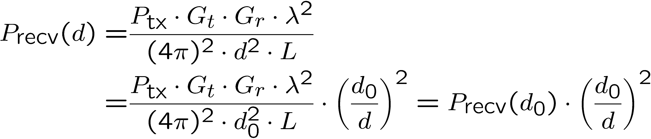
Attenuation
Friis free-space model:

Slide 23
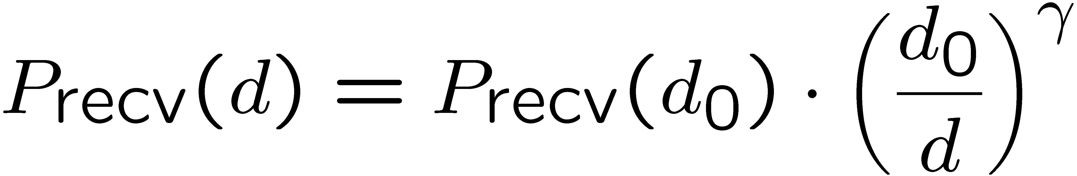
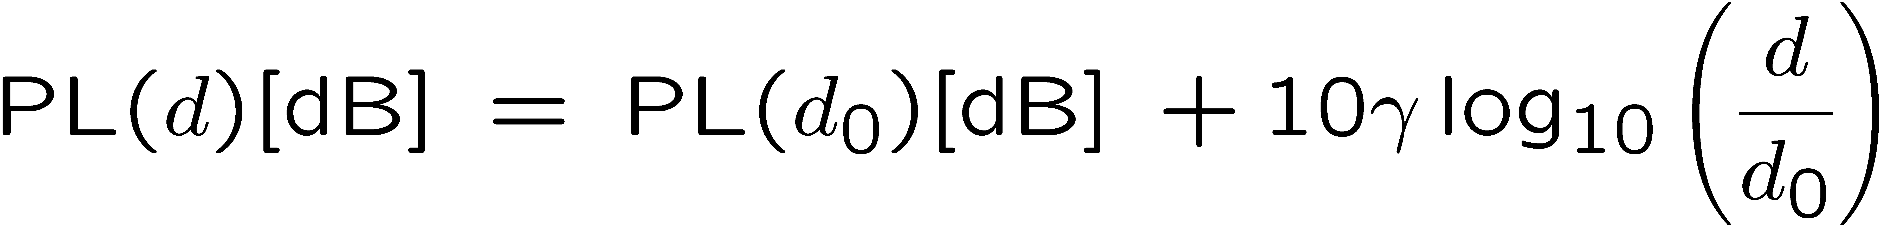
Attenuation
To take into account stronger attenuation than only caused by distance (e.g., walls, …), use a larger exponent γ > 2
γ is the path-loss exponent
Rewrite in logarithmic form (in dB):

Slide 24
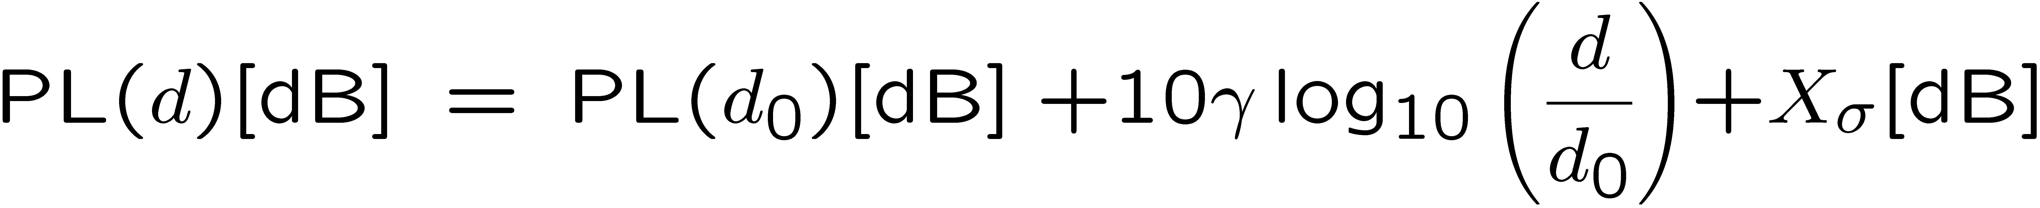
Attenuation
Obstacles, multi-path, etc?
Experiments show can be represented by a random variable
Equivalent to multiplying with a lognormal distributed r.v. in metric units ! lognormal fading

Slide 25
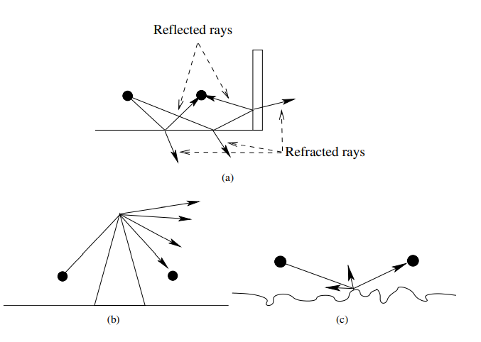
Multi-path Effects

Slide 26
Multi-path Effects
Reflection and scattering from a surface generally result in multiple copies of the signal being received at the receiver.
This is mainly related to the omnidirectional propagation of signal waves from the transmitter.
One can visualize multiple rays propagating away from the transmitter in all directions. Because of the reflection and scattering, multiple paths exist through which these rays can reach the receiver.
The direct path between the transmitter and receiver is called the line-of-sight (LoS) path. In addition to the LoS path between a transmitter and the receiver, a group of rays may also reflect or scatter from surrounding surfaces and reach the receiver.
These paths are referred to as the non-line-of-sight (NLoS) paths. Those NLoS rays that encounter attenuation comparable to the LoS path also contribute to the success of the communication. These effects are called multi-path effects because of the multiple rays that are received at the receiver from different paths.

Slide 27
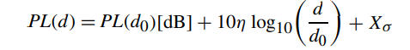
Multi-path Effects
For short range communication such as in WSNs, the multi-path effects are modeled by a log-normal random variable [34]. As a result, the path loss formula can be rewritten as
Received
Power
Path loss
Path loss
exponent
Log-normal
Shadow fading

Slide 28
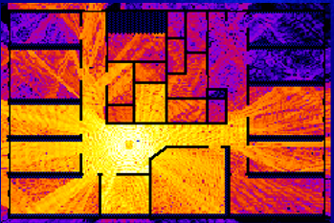
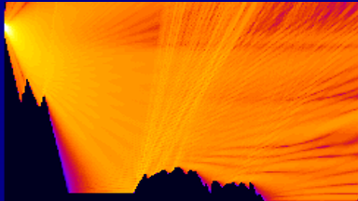
Multi-path
Brighter color = stronger signal
Simple (quadratic) free space attenuation formula is not sufficient to capture these effects

Slide 29
Channel Error Rate
The channel model developed so far captures the effects of signal propagation from a single transmitter.
The received signal strength at a receiver can be found. However, the success of wireless communication depends not only on the received signal strength from a single transmitter but also on the effects of transceiver noise and interference from other users.
To be able to capture the channel error rate in terms of bits that are transmitted (bit error rate (BER)) and packets that are transmitted (packet error rate (PER)), the multi-user wireless environment should be considered.
Accordingly, the following two additional sources of distortion should also be considered:
Noise
Interference

Slide 30
Channel Error Rate
• Noise: The receiver electronics as well as external sources result in non-negligible noise that affects the accuracy of signal reception. This is generally referred to as the receiver sensitivity, which is the minimum signal strength required for the receiver to decode the waveform. Noise generally depends on the particular receiver architecture, the environment, as well as the temperature.
• Interference: The wireless channel is a multi-user environment due to its broadcast nature. As a result, more than one device may transmit at the same time, which creates co-channel interference.

Slide 31
Channel Error Rate
To be able to capture the channel error rate in terms of bits that are transmitted (bit error rate (BER)) and packets that are transmitted (packet error rate (PER)), the multi-user wireless environment should be considered.
The following two additional sources of distortion should also be considered:
Noise: due to effects in receiver electronics, depends on temperature.
Interference: from third parties.
Co-channel interference: another sender uses the same spectrum.
Adjacent-channel interference: another sender uses some other part of the radio spectrum, but receiver filters are not good enough to fully suppress it.

Slide 32
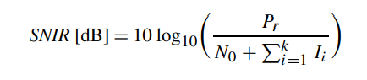
Symbols and Bit Errors
Extracting symbols out of a distorted/corrupted wave form is fraught with errors
Depends essentially on strength of the received signal compared to the corruption
Captured by signal to noise and interference ratio (SINR)

Slide 33
Symbols and Bit Errors
For WSN
Interference is usually low → MAC protocols
SINR ~ SNR
SNR = P_{r} – P_{n} (in dB)
P_{n} – Noise power (noise floor)

Slide 34
Noise Floor
Changes with time
Varies according to location (indoor vs. outdoor)
Even if received power is the same, SNR varies with time!

Slide 35
Bit Error Rate
p_{b} – Probability that a received bit will be in error
1 sent → 0 received
p_{b} is proportional to SNR (channel quality)
Exact relation depends on modulation scheme

Slide 36
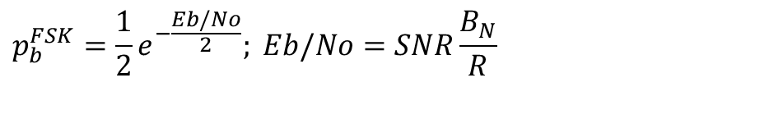
Bit Error Rate
Mica2 nodes use frequency shift keying (FSK)
Bandwidth
$$p_{b}^{FSK}=\frac{1}{2}e^{−\frac{Eb/No}{2}}; Eb/No=SNR\frac{B_{N}}{R}$$
Bit rate

Slide 37
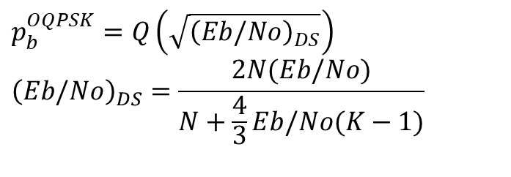
Bit Error Rate
CC2420 (MicaZ, Tmote, SunSPOT) use offset quadrature phase shift keying (O-QPSK) with direct sequence spread spectrum (DSSS).
$$p_{b}^{OQPSK}=Q\left(\sqrt{{\left(Eb/No\right)}_{DS}}\right) \\ {\left(Eb/No\right)}_{DS}=\frac{2N(Eb/No)}{N+\frac{4}{3}Eb/No(K−1)}$$
# of chips per bit (16)
=2 for MicaZ

Slide 38
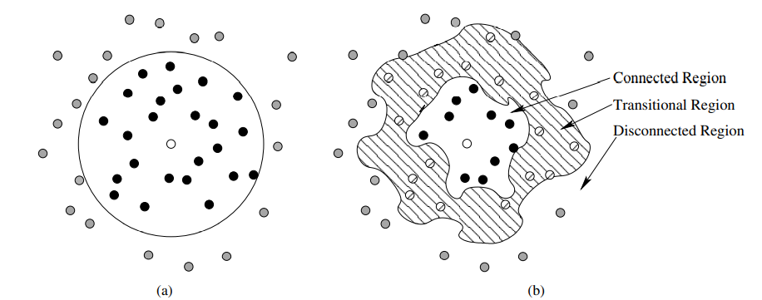
Channel models for WSNs
a) Unit Disc Graph Model: (UDG) model represents the range of a node as a disc centered around the node with a radius of 1.
This model leads to the definition of communication range of a node as a fixed distance, rcomm.
b) Statistical Channel Models: Compared to the UDG model, statistical channel models capture the randomness in the wireless channel more accurately.

Slide 39
Channel Models
Non-line-of-sight path
Amplitude of resulting signal has a Rayleigh distribution (Rayleigh fading)
One dominant line-of-sight plus many indirect paths
Signal has a Rice distribution (Rice fading)

Slide 40
Non-line-of-sight
Because of reflection, scattering, …, radio communication is not limited to direct line of sight communication
Effects depend strongly on frequency, thus different behavior at higher frequencies
Non-line-of-sight path
Line-of- sight path

Slide 41
Non-line-of-sight
Different paths have different lengths = propagation time.
Results in delay spread of the wireless channel
multipath
pulses
LOS pulses
signal at receiver

Slide 42
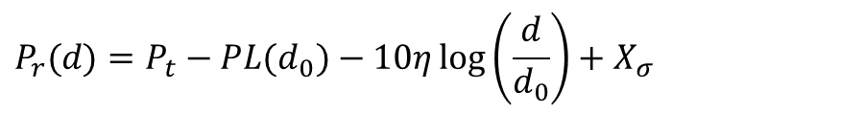
Channel Model for WSN
Log-normal fading channel best characterizes
WSN channels.
Empirical evaluations for Mica2.
$$P_{r}(d)=P_{t}−PL(d_{0})−10η\log\left(\frac{d}{d_{0}}\right)+X_{σ}$$

Slide 43
Channel Model for WSN
PRR – Packet reception rate (1-p_{b})^{k}
Transitional region for packet reception.
Not too good, not too bad.

Slide 44
Channel Model for WSN
PRR significantly varies in the transitional region
d = 20m
PRR = [0,1]
We cannot operate solely in the connected region
Communication distance too short

Slide 45
Channel Model for WSN

Slide 46
Channel Model for WSN

Slide 47
Channel Models – Digital
Directly model the resulting bit error behavior (p_{b})
Each bit is erroneous with constant probability, independent of the other bits
Binary symmetric channel (BSC)
Capture fading models’ property that channel is in different states! Markov models – states with different BERs
Example: Gilbert-Elliot model with “bad” and “good” channel states and high/low bit error rates
p_{gg}
good
bad
p_{bb}
p_{bg}

Slide 48
Channel Models – Digital
Fractal channel models describe number of (in-)correct bits in a row by a heavy-tailed distribution
Burst errors (bit errors are NOT independent)

Slide 49
PHY Layer Standards
Standardization in WSNs has been a major challenge. Over the years, various types of platforms have been developed, mainly for research purposes. However, due to the independent development of these platforms, interdependency has been a problem among them.
Recently, the IEEE has undertaken a worldwide effort to develop a standard for low-power wireless communication. As a result, the IEEE 802.15.4 standard was developed. Since its establishment, this standard has been adopted by the majority of the platforms and industrial applications as the de facto standard for WSNs.

Slide 50
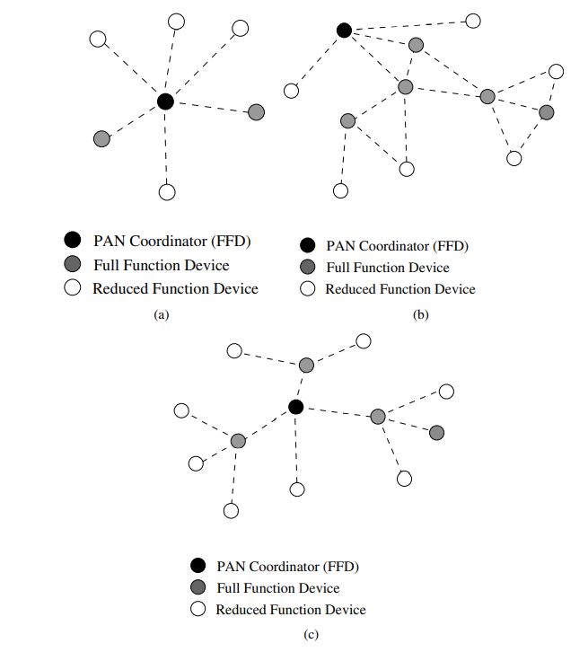
IEEE 802.15.4
The MAC layer provides communication for star, mesh, and cluster tree-based topologies with controllers.

Slide 51
Radio spectrum for communication
Which part of the electromagnetic spectrum is used for communication
Not all frequencies are equally suitable for all tasks – e.g., wall penetration, different atmospheric attenuation (oxygen resonances, …)

Slide 52
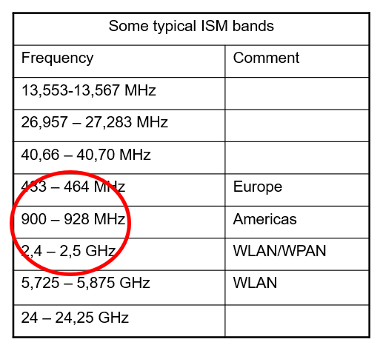
Frequency allocation
Some frequencies are allocated to specific uses
Cellular phones, analog television/radio broadcasting, DVB-T, radar, emergency services, radio astronomy, …
Particularly interesting: ISM bands (“Industrial, scientific, medicine”) – license-free operation

Slide 53
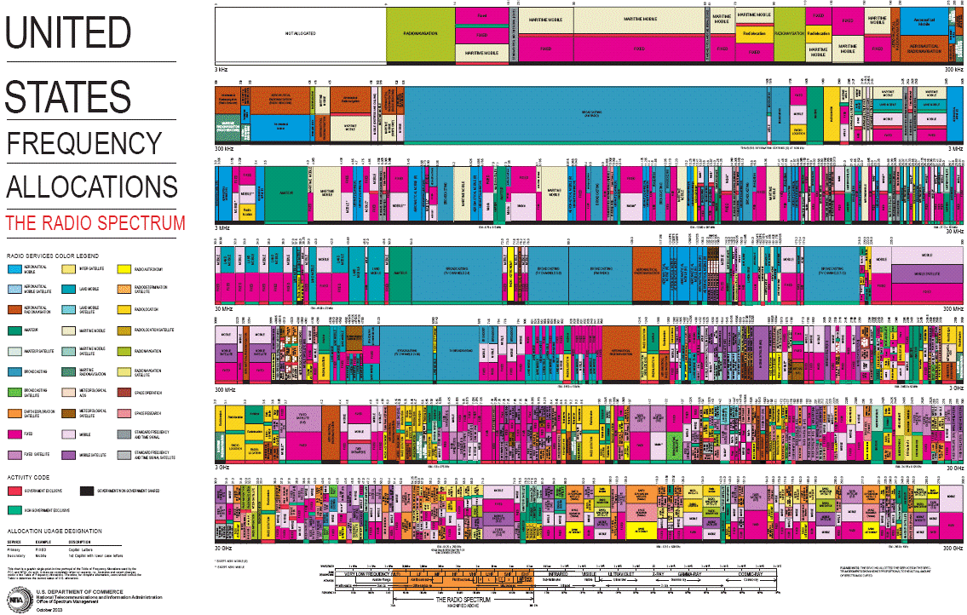
Example: US frequency allocation

Slide 54
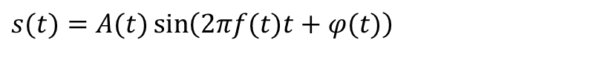
Transmitting Data Using Radio Waves
Basics: Wireless communication is performed through radio waves
Transmitter can send a radio wave
Receiver can detect the wave and its parameters
Typical radio wave = sine function:
Parameters: amplitude A(t), frequency f(t), phase φ(t)
Modulation: Manipulate these parameters
$$s(t)=A(t)\sin\left(2πf(t)t+φ(t)\right)$$

Slide 55
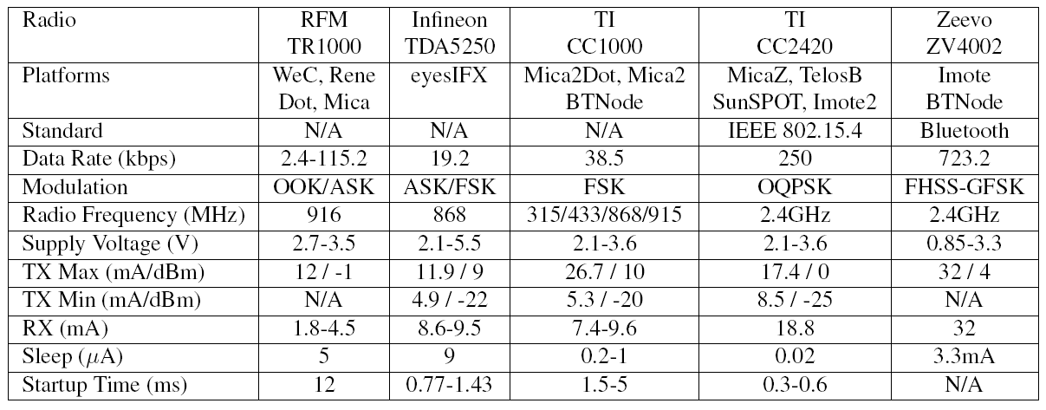
Existing transceivers used in WSNs

